Slide 1



University Institute of Engineering
DEPARTMENT OF COMPUTER SCIENCE & ENGINEERING
Subject Name: Software Engineering
Subject Code: 23CST-206
Er. Jagmeet Kaur
E8387
ASSISTANT PROFESSOR
CSE
DISCOVER . LEARN . EMPOWER

Slide 2
Introduction to Software Engineering
Course Outcome
CO Number | Title | Level
CO3 | Prepare SRS and software process metrics for a given requirement. | Analyse
CO4 | Prepare Test Suite and Quality Assurance plan for a given project. | Create

Slide 3
Topics covered
Functional and non functional requirement
Decision tree
Decision table
Data Modeling
Functional Modeling
Behavioral Modeling

Slide 4
FUNCTIONAL REQUIREMENTS
Functional requirements describe:
A set of high-level requirements
Each high-level requirement:
takes in some data from the user
outputs some data to the user
Each high-level requirement:
might consist of a set of identifiable functions
For each high-level requirement:
Every function is described in terms of:
Input data set
Output data set
Processing required to obtain the output data set from the input data set.

Slide 5
FUNCTIONAL REQUIREMENTS
A Functional Requirement is a description of the service that the software must offer.
It describes a software system or its component.
A function is nothing but inputs to the software system, its behavior, and outputs.
It can be a calculation, data manipulation, business process, user interaction, or any other specific functionality which defines what function a system is likely to perform.
Functional Requirements are also called Functional Specification.

Slide 6
FUNCTIONAL REQUIREMENTS
In software engineering and systems engineering, a Functional Requirement can range from the high-level abstract statement of the sender's necessity to detailed mathematical functional requirement specifications.
Functional software requirements help you to capture the intended behavior of the system.

Slide 7
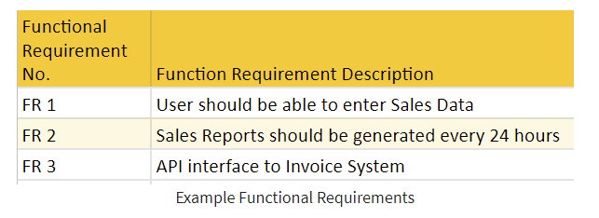
FUNCTIONAL REQUIREMENTS : EXAMPLE

Slide 8
Functional requirement should include:
Details of operations conducted in every screen
Data handling logic should be entered into the system
It should have descriptions of system reports or other outputs
Complete information about the workflows performed by the system
It should clearly define who will be allowed to create/modify/delete the data in the system
How the system will fulfill applicable regulatory and compliance needs should be captured in the functional document

Slide 9
Benefits of Functional Requirement
Helps you to check whether the application is providing all the functionalities that were mentioned in the functional requirement of that application
A functional requirement document helps you to define the functionality of a system or one of its subsystems.
Functional requirements along with requirement analysis help identify missing requirements. They help clearly define the expected system service and behavior.
Errors caught in the Functional requirement gathering stage are the cheapest to fix.
Support user goals, tasks, or activities

Slide 10
Types of Functional Requirements
Transaction Handling
Business Rules
Certification Requirements
Reporting Requirements
Administrative functions
Authorization levels
Audit Tracking
External Interfaces
Historical Data management
Legal and Regulatory Requirements

Slide 11
NON FUNCTIONAL REQUIREMENTS
Characteristics of the system which can not be expressed as functions:
Maintainability,
Portability,
Usability, etc.
Non functional requirements include:
Reliability issues,
Performance issues:
Example: How fast the system can produce results
so that it does not overload another system to which it supplies data, etc.
Human-computer interface issues,
Interface with other external systems,
Security, maintainability, etc.

Slide 12
NON FUNCTIONAL REQUIREMENTS
NON-FUNCTIONAL REQUIREMENT (NFR) specifies the quality attribute of a software system.
They judge the software system based on Responsiveness, Usability, Security, Portability and other non-functional standards that are critical to the success of the software system.
Example of nonfunctional requirement, “how fast does the website load?”
Failing to meet non-functional requirements can result in systems that fail to satisfy user needs.

Slide 13
NON FUNCTIONAL REQUIREMENTS
Non-functional Requirements allows you to impose constraints or restrictions on the design of the system across the various agile backlogs.
Example, the site should load in 3 seconds when the number of simultaneous users are > 10000.

Slide 14
TYPES OF NON-FUNCTIONAL REQUIREMENTS
Usability requirement
Serviceability requirement
Manageability requirement
Recoverability requirement
Security requirement
Data Integrity requirement
Capacity requirement
Availability requirement
Scalability requirement
Interoperability requirement
Reliability requirement
Maintainability requirement
Regulatory requirement
Environmental requirement

Slide 15
Examples of Non-functional requirements
Users must change the initially assigned login password immediately after the first successful login. Moreover, the initial should never be reused.
Employees never allowed to update their salary information. Such attempt should be reported to the security administrator.
Every unsuccessful attempt by a user to access an item of data shall be recorded on an audit trail.
A website should be capable enough to handle 20 million users with affecting its performance
The software should be portable. So moving from one OS to other OS does not create any problem.
Privacy of information, the export of restricted technologies, intellectual property rights, etc. should be audited.

Slide 16
Advantages of Non-Functional Requirement
The nonfunctional requirements ensure the software system follow legal and compliance rules.
They ensure the reliability, availability, and performance of the software system
They ensure good user experience and ease of operating the software.
They help in formulating security policy of the software system.

Slide 17
Disadvantages of Non-functional requirement
None functional requirement may affect the various high-level software subsystem
They require special consideration during the software architecture/high-level design phase which increases costs.
Their implementation does not usually map to the specific software sub-system,
It is tough to modify non-functional once you pass the architecture phase.

Slide 18
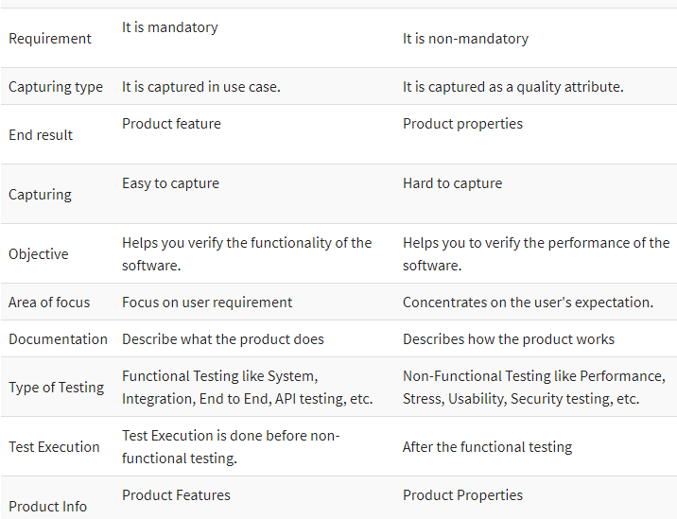
Functional Vs Non-Functional requirements

Slide 19
Representation of complex processing logic
Decision trees
Decision tables

Slide 20
Decision Tree
A decision tree is a map of the possible outcomes of a series of related choices.
It allows an individual or organization to weigh possible actions against one another based on their costs, probabilities, and benefits.
They can be used either to drive informal discussion or to map out an algorithm that predicts the best choice mathematically.
A decision tree typically starts with a single node, which branches into possible outcomes. Each of those outcomes leads to additional nodes, which branch off into other possibilities. This gives it a treelike shape.

Slide 21
Decision Tree
There are three different types of nodes: chance nodes, decision nodes, and end nodes.
A chance node, represented by a circle, shows the probabilities of certain results.
A decision node, represented by a square, shows a decision to be made, and an end node shows the final outcome of a decision path.

Slide 22
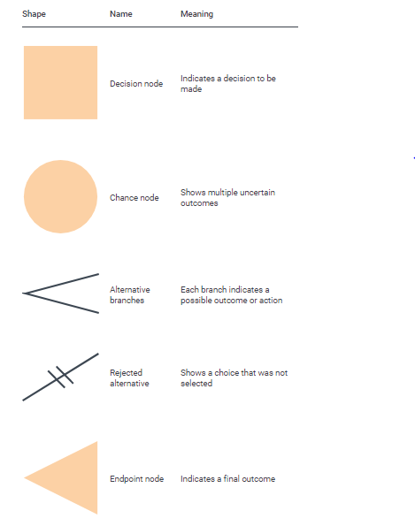
Decision Tree Symbols

Slide 23
Decision Tree
A Decision Tree offers a graphic read of the processing logic concerned in a higher cognitive process and therefore the corresponding actions are taken.
The perimeters of a choice tree represent conditions and therefore the leaf nodes represent the actions to be performed looking on the result of testing the condition.

Slide 24
Example
For example, consider Library Membership Automation Software (LMS) where it ought to support the following three options: New member, Renewal, and Cancel membership. These are explained as following below.
1. New Member Option:
Decision: Once the ‘new member’ possibility is chosen, the software system asks details concerning the member just like the member’s name, address, number, etc.
Action: If correct info is entered then a membership record for the member is made and a bill is written for the annual membership charge and the protection deposit collectible.

Slide 25
Example
2 Cancel Membership Option:
Decision: If the ‘cancel membership’ possibility is chosen, then the software system asks for member’s name and his membership range.
Action: The membership is off, a cheque for the balance quantity because of the member is written and at last the membership record is deleted from the information.
3 Renewal Option:
Decision: If the ‘renewal’ possibility is chosen, the LMS asks for the member’s name and his membership range to test whether or not he’s a sound member or not.
Action: If the membership is valid then membership ending date is updated and therefore the annual membership bill is written, otherwise, a slip-up message is displayed.

Slide 26
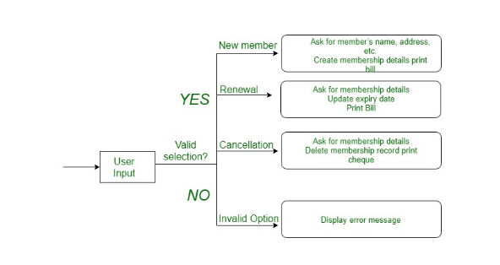
Example
Fig 1 Example of decision tree

Slide 27
Advantages
The advantages of decision tree are as follow:
They are easy to understand
They can be useful with or without hard data, and any data requires minimal preparation
New options can be added to existing trees
Their value in picking out the best of several options

Slide 28
Disadvantages
When dealing with categorical data with multiple levels, the information gain is biased in favor of the attributes with the most levels.
Calculations can become complex when dealing with uncertainty and lots of linked outcomes.
Conjunctions between nodes are limited to AND, whereas decision graphs allow for nodes linked by OR.

Slide 29
Decision table
Decision tables specify:
Which variables are to be tested
What actions are to be taken if the conditions are true,
The order in which decision making is performed.
A decision table shows in a tabular form:
Processing logic and corresponding actions
Upper rows of the table specify:
The variables or conditions to be evaluated
Lower rows specify:
The actions to be taken when the corresponding conditions are satisfied.

Slide 30
Decision table
In technical terminology,
a column of the table is called a rule:
A rule implies:
if a condition is true, then execute the corresponding action.

Slide 31
Decision Table
Decision table is a brief visual representation for specifying which actions to perform depending on given conditions.
The information represented in decision tables can also be represented as decision trees or in a programming language using if-then-else and switch-case statements.
A decision table is a good way to settle with different combination inputs with their corresponding outputs and also called cause-effect table.
Reason to call cause-effect table is a related logical diagramming technique called cause-effect graphing that is basically used to obtain the decision table.

Slide 32
Importance of Decision Table
Decision tables are very much helpful in test design technique.
It helps testers to search the effects of combinations of different inputs and other software states that must correctly implement business rules.
It provides a regular way of stating complex business rules, that is helpful for developers as well as for testers.
It assists in development process with developer to do a better job. Testing with all combination might be impractical.
A decision table is basically an outstanding technique used in both testing and requirements management.
It is a structured exercise to prepare requirements when dealing with complex business rules.
It is also used in model complicated logic.

Slide 33
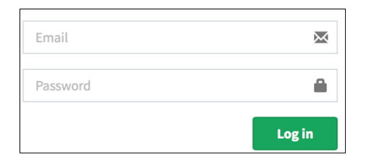
Example: How to make Decision Base Table for Login Screen
Let's create a decision table for a login screen.

Slide 34
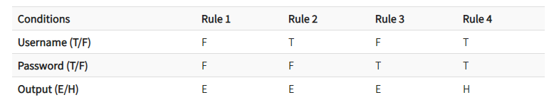
Example
The condition is simple if the user provides correct username and password the user will be redirected to the homepage. If any of the input is wrong, an error message will be displayed.

Slide 35
Example
Notations
T – Correct username/password
F – Wrong username/password
E – Error message is displayed
H – Home screen is displayed
Interpretation:
Case 1 – Username and password both were wrong. The user is shown an error message.
Case 2 – Username was correct, but the password was wrong. The user is shown an error message.
Case 3 – Username was wrong, but the password was correct. The user is shown an error message.
Case 4 – Username and password both were correct, and the user navigated to homepage

Slide 36
Advantages and Disadvantages
Advantages
When the system behavior is different for different input and not same for a range of inputs, both equivalent partitioning, and boundary value analysis won't help, but decision table can be used.
The representation is simple so that it can be easily interpreted and is used for development and business as well.
This table will help to make effective combinations and can ensure a better coverage for testing
Any complex business conditions can be easily turned into decision tables
In a case we are going for 100% coverage typically when the input combinations are low, this technique can ensure the coverage.
Disadvantages
The main disadvantage is that when the number of input increases the table will become more complex

Slide 37
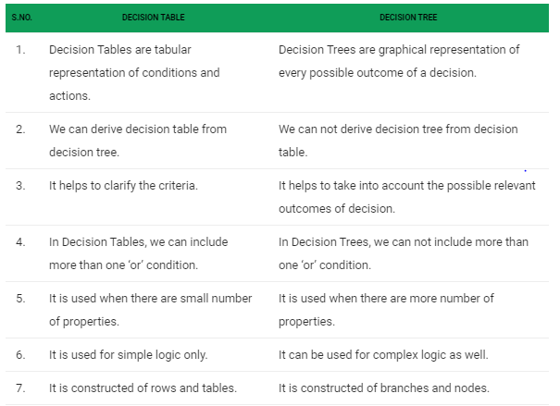
Comparison

Slide 38
Formal specification
A formal specification technique is a mathematical method to:
Accurately specify a system.
Verify that implementation satisfies specification.
Prove properties of the specification. A formal software specification is a statement expressed in a language whose vocabulary, syntax, and semantics are formally defined.
The need for a formal semantic definition means that the specification languages cannot be based on natural language; it must be based on mathematics.

Slide 39
Formal Specification
Advantages:
Well-defined semantics, no scope for ambiguity
Automated tools can check properties of specifications
Executable specification
The development of a formal specification provides insights and understanding of the software requirements and the software design.
Given a formal system specification and a complete formal programming language definition, it may be possible to prove that a program conforms to its specifications.
Formal specification may be automatically processed. Software tools can be built to assist with their development, understanding, and debugging.

Slide 40
Formal Specification
Depending on the formal specification language being used, it may be possible to animate a formal system specification to provide a prototype system.
Formal specifications are mathematical entities and may be studied and analyzed using mathematical methods.
Formal specifications may be used as a guide to the tester of a component in identifying appropriate test cases.

Slide 41
Formal specification
Disadvantages of formal specification techniques:
Difficult to learn and use
Not able to handle complex systems
Mathematical techniques used include:
Logic-based
set theoretic
algebraic specification
finite state machines, etc.

Slide 42
Formal Specification
Formal specifications sometimes are not used because:
Software management is conservative and unwilling to adopt new techniques whose payoff is not immediately obvious.
Most software engineers have not been trained in formal specification techniques.
Some classes of systems are difficult to specify using existing specification techniques. Interactive and interrupt driven systems might be examples.

Slide 43
APPLICATIONS
Managing clients requirements in industry.
Generating software for noticing health activities with novel smart technologies.
Content Management and to analyzing Fraud detection and Prevention
Advertisements Targeting Platforms Managing content, posts, images and videos on social media platforms
Analyzing customer data in real-time for improving business performance
Public sector fields such as intelligence, defense, cyber security and scientific research

Slide 44
Data Modeling
A data model can be thought of as a flowchart that illustrates the relationships among data.
It enables stakeholders to identify errors and make changes before any programming code has been written.
Alternatively, models can be introduced as part of reverse engineering efforts that extract models from existing systems, as seen with NoSQL data.
Data modelers often use multiple models to view the same data and ensure that all processes, entities, relationships and data flows have been identified.
Data modeling stages roughly break down into creation of logical data models that show specific attributes, entities and relationships among entities and the physical data model.

Slide 45
Functional Modeling
In the Functional Model, software converts information. and to accomplish this, it must perform at least three common tasks- input, processing and output.
When functional models of an application are created, the software engineer emphasizes problem specific tasks. The functional model begins with a single reference level model

Slide 46
Functional Modeling
In a series of iterations, more and more functional detail is given, until all system functionality is fully represented.
Information is converted because it flows from a computer-based system.
The system takes input in various forms; Hardware, software, and human elements are applied to replace it; And produces in various forms.

Slide 47
Behavioral Modeling
Behavioral model describes the interaction in the system. It represents the interaction among the structural diagrams. Behavioral modeling shows the dynamic nature of the system. They consist of the following:
Activity diagrams
Interaction diagrams
Use case diagrams

Slide 48
REFERENCES
Reference Books:
Suman Ugrasen, “Software Engineering - Concepts and Practices”, First Edition, Cengage.
Mohammad Ali Shaikh, “Software Engineering with UML”, Third Edition, Notion Press.
Somerville Ian, “Software Engineering”, Addison Wesley, 8th Edition.
Text Books:
Pressman Rogers, “Software Engineering: A Practitioner's Approach”, Sixth edition. Patterson and Hennessy, “Computer Architecture” , Fifth Edition Morgaon Kauffman.
Rajib Mall, “Fundamentals of Software Engineering’’, Fourth Edition, Pearson, PHI.
Reference Website
https://www.geeksforgeeks.org/computer-organization-and-architecture-tutorials/

Slide 49
THANK YOU

